Slide 1
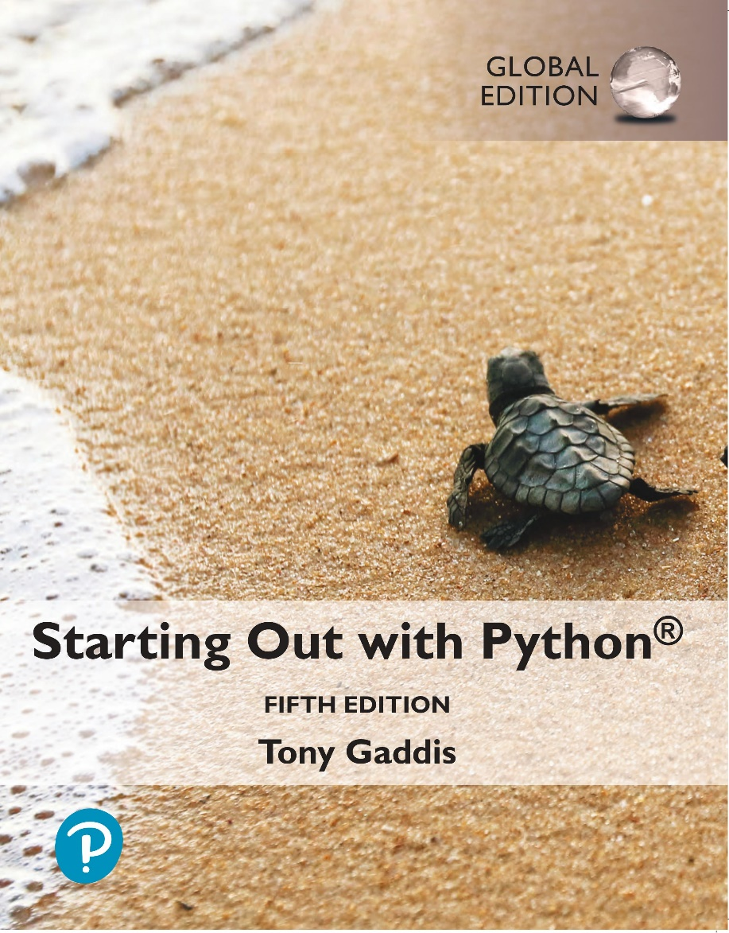
Starting out with Python
Fifth Edition, Global Edition
Chapter 12
Recursion
Copyright © 2022 Pearson Education, Ltd. All Rights Reserved.

Slide 2
Topics
Introduction to Recursion
Problem Solving with Recursion
Examples of Recursive Algorithms

Slide 3
Introduction to Recursion (1 of 3)
Recursive function: a function that calls itself
Recursive function must have a way to control the number of times it repeats
Usually involves an if-else statement which defines when the function should return a value and when it should call itself
Depth of recursion: the number of times a function calls itself

Slide 4
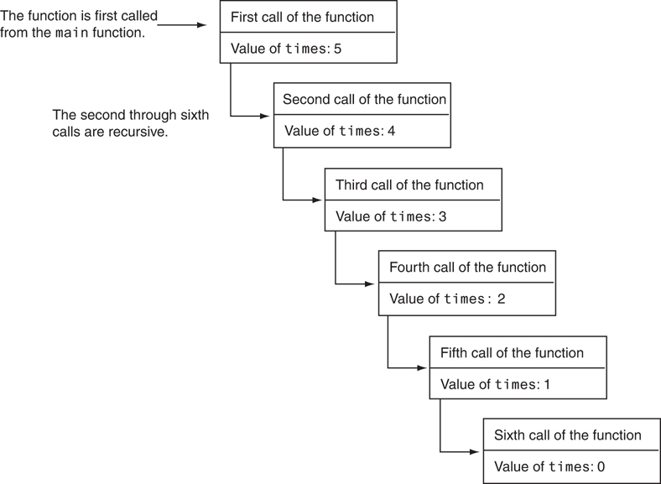
Introduction to Recursion (2 of 3)
Figure 12-2 Six calls to the message function

Slide 5
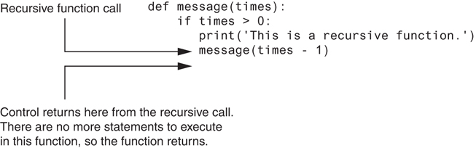
Introduction to Recursion (3 of 3)
Figure 12-3 Control returns to the point after the recursive function call

Slide 6
Problem Solving with Recursion (1 of 2)
Recursion is a powerful tool for solving repetitive problems
Recursion is never required to solve a problem
Any problem that can be solved recursively can be solved with a loop
Recursive algorithms usually less efficient than iterative ones
Due to overhead of each function call

Slide 7
Problem Solving with Recursion (2 of 2)
Some repetitive problems are more easily solved with recursion
General outline of recursive function:
If the problem can be solved now without recursion, solve and return
Known as the base case
Otherwise, reduce problem to smaller problem of the same structure and call the function again to solve the smaller problem
Known as the recursive case

Slide 8
Using Recursion to Calculate the Factorial of a Number
In mathematics, the n! notation represents the factorial of a number n
For n = 0, n! = 1
For n > 0, n! = 1 x 2 x 3 x … x n
The above definition lends itself to recursive programming
n = 0 is the base case
n > 0 is the recursive case
factorial(n) = n x factorial(n-1)

Slide 9
Using Recursion (1 of 3)
# The factorial function uses recursion to
# calculate the factorial of its argument,
# which is assumed to be nonnegative.
def factorial(num):
if num == 0:
return 1
else:
return num * factorial(num – 1)

Slide 10
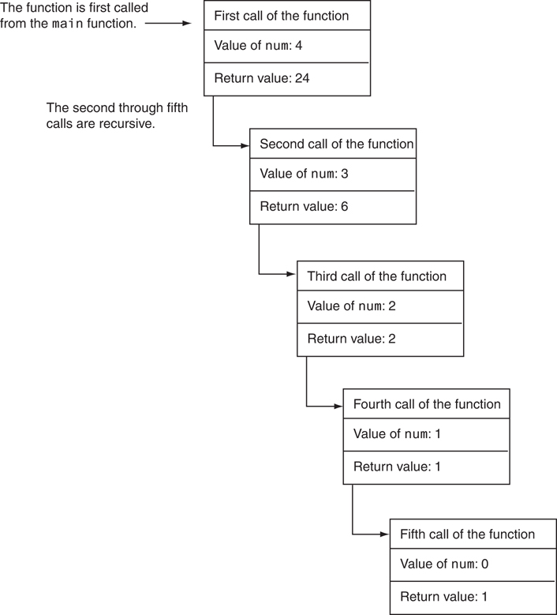
Using Recursion (2 of 3)
Figure 12-4 The value of num and the return value during each call of the function

Slide 11
Using Recursion (3 of 3)
Since each call to the recursive function reduces the problem:
Eventually, it will get to the base case which does not require recursion, and the recursion will stop
Usually the problem is reduced by making one or more parameters smaller at each function call

Slide 12
Direct and Indirect Recursion
Direct recursion: when a function directly calls itself
All the examples shown so far were of direct recursion
Indirect recursion: when function A calls function B, which in turn calls function A

Slide 13
The Fibonacci Series
Fibonacci series: has two base cases
if n = 0 then Fib(n) = 0
if n = 1 then Fib(n) = 1
if n > 1 then Fib(n) = Fib(n-1) + Fib(n-2)
Corresponding function code:
# The fid function returns the nth number
# in the Fibonacci series
def fib(n):
if n == 0:
return 0
elif n == 1:
return 1
else:
return fib(n - 1) + fib(n – 2)

Slide 14
Finding the Greatest Common Divisor
Calculation of the greatest common divisor (GCD) of two positive integers
If x can be evenly divided by y, then
gcd(x,y) = y
Otherwise, gcd(x,y) = gcd(y, remainder of x/y)
Corresponding function code:
# The gcd function returns the greatest common
# divisor of two numbers.
def gcd(x,y):
if x % y == 0:
return y
else:
return gcd(x, x % y)

Slide 15
The Towers of Hanoi (1 of 5)
Mathematical game commonly used to illustrate the power of recursion
Uses three pegs and a set of discs in decreasing sizes
Goal of the game: move the discs from leftmost peg to rightmost peg
Only one disc can be moved at a time
A disc cannot be placed on top of a smaller disc
All discs must be on a peg except while being moved

Slide 16
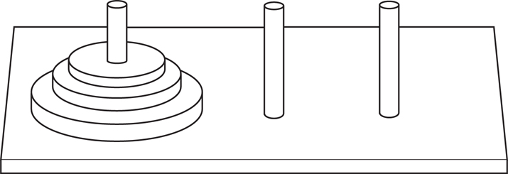
The Towers of Hanoi (2 of 5)
Figure 12-5 The pegs and discs in the Tower of Hanoi game

Slide 17
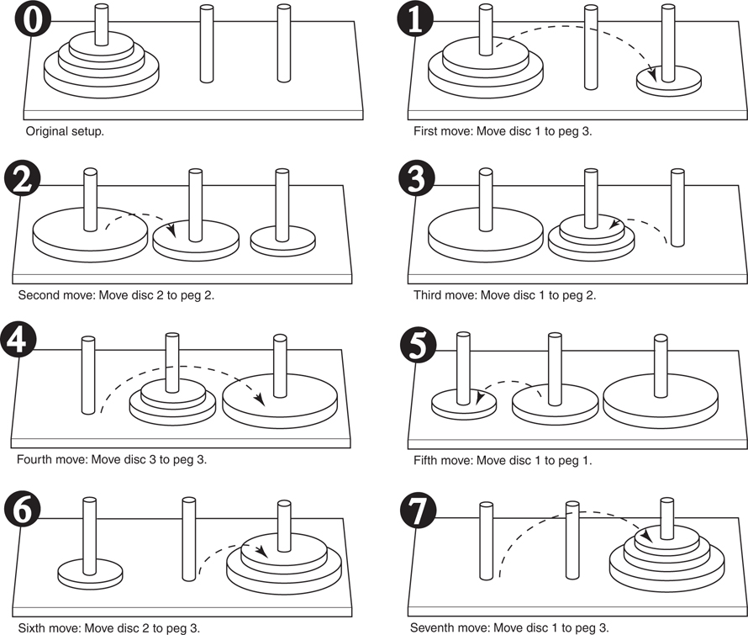
The Towers of Hanoi (3 of 5)
Figure 12-6 Steps for moving three pegs

Slide 18
The Towers of Hanoi (4 of 5)
Problem statement: move n discs from peg 1 to peg 3 using peg 2 as a temporary peg
Recursive solution:
If n == 1: Move disc from peg 1 to peg 3
Otherwise:
Move n-1 discs from peg 1 to peg 2, using peg 3
Move remaining disc from peg 1 to peg 3
Move n-1 discs from peg 2 to peg 3, using peg 1

Slide 19
The Towers of Hanoi (5 of 5)
# The moveDiscs function displays a disc move in
# the powers of Hanoi game.
# The parameters are:
# num: The number of discs to move.
# from_peg: The peg to move from.
# to_peg: The peg to move to.
# temp_peg: The temporary peg.
def move_disces(num, from_peg, to_peg, temp_peg):
if num > 0:
move_disces(num – 1, from_peg, temp_peg, to_peg)
print(‘Move a disc from peg’, from_peg, ‘to peg’, to_peg)
move_disces(num – 1, temp_peg, to_peg, from_peg)

Slide 20
Recursion versus Looping
Reasons not to use recursion:
Less efficient: entails function calling overhead that is not necessary with a loop
Usually a solution using a loop is more evident than a recursive solution
Some problems are more easily solved with recursion than with a loop
Example: Fibonacci, where the mathematical definition lends itself to recursion

Slide 21
Summary
This chapter covered:
Definition of recursion
The importance of the base case
The recursive case as reducing the problem size
Direct and indirect recursion
Examples of recursive algorithms
Recursion versus looping

